Slide 1
The
Driving Project Ontology
CS 7810
Final Project Presentation
Jehan Fernando
Christopher Menart
Alex Moore

Slide 2
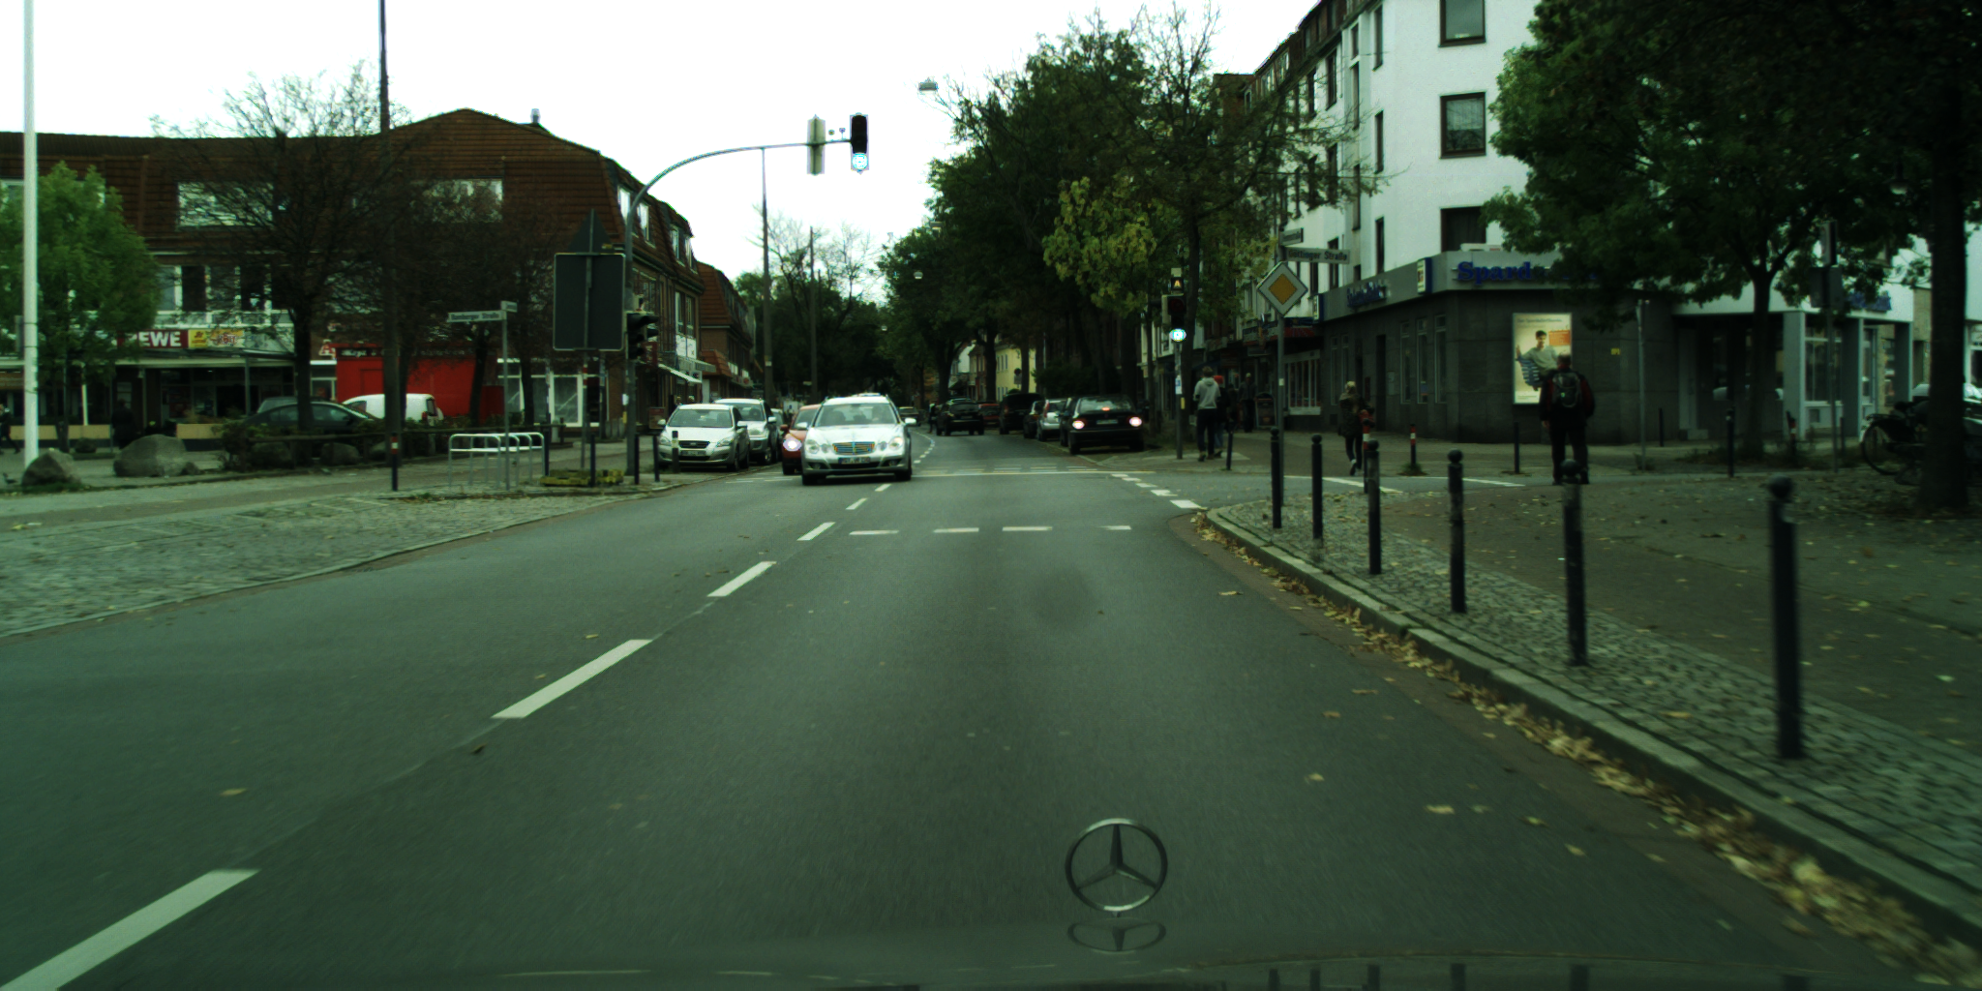
Motivation/Scenario
Picture the scene: You’re a self-driving car, trundlin’ over the streets of Bochum, Germany, when all of a sudden you ask yourself:
Can I legally switch over to the left lane?
What does this depend on?
Traffic rules
Potential obstacle positions
Notes:
Chris: Let’s set the stage: there’s a problem out there that needs solving. You’re a self-driving car, looking for trouble on the mean streets of Germany, when all of a sudden, you go–how do I navigate this road? There’s a car in front of me. There’s an intersection where I want to turn. There’s a person going across a cross-walk on a different road, and there’s a funny-looking sign hanging over-head. That’s a lot of stuff, but what does it mean? What’s safe? What am I allowed to do?
Who among us hasn’t been there?
So we are building a knowledge graph that models the kind of information necessary to answer those questions. The reason this is an interesting problem to tackle with semantics is that the parts of self-driving cars we mostly know about are deep learning systems hooked up to optical and LIDAR sensors.
But your typical deep learning system doesn’t really do this. At the very least, the kind of deep learning systems that appear in conferences, that participate in academic competitions, aren’t doing this. They aren’t even about this. They are about building up a picture of your environment that answers the questions A) What is around me, and B) Where is it?
The academic literature on deep learning to answer those questions has grown very effective and sophisticated in the last few years. And that’s good! Great, even! But answering those questions is not all that a self-driving car needs to do.
In order to actually navigate a moment-to-moment environment, you have to understand things like traffic laws and regulations, just to use an easy target, which could change not only over time but based on where you are in the world. Answering those questions reliably with deep learning–at least deep learning alone–is difficult to the point of being most likely impractical.
I don’t want to oversell our project–not only is our one-semester effort not up to the complete task of autonomous navigation, one has to assume that Tesla and other car companies have *something* proprietary, already, which does this, otherwise their self-driving cars just wouldn’t work. It might be deep reinforcement-learning based, or only partially, or it might not. We can’t really know for sure.
But it was a neat idea for coursework.

Slide 3
Competency Questions
"Which scenarios include restrictions based on the current temperature?"
"What is the current speed of the car?"
"Which scenarios have temperatures above 10 degrees Celsius?"
"In which scenarios can the car merge to the right and/or left?"
"Which scenarios contain more than 4 cars?"
"What is the average number of cars in a scenario?"
"In which scenarios is there a railroad-crossing currently closed for train access?"
"In which scenarios is the current road a one-way street?"
"Which scenarios have more than two lanes in the current road?"
"In which scenarios is there an object moving into the lane?"
"In which scenarios does the car need to stop or slow down?"
Notes:
These are our actual current competency questions, by which I mean the queries we were able to run.
At one point in time, very early on, we thought we would be able to specify what maneuvers were allowable in a given circumstance via axioms. This proved…naive. The logic that determines what you can do was too complex, at least for neophytes like us to arrange via axioms.
Realistically, as Cogan mentioned to us near the end of the course, a system like this would have the knowledge graph as part of a larger system. It could make SPARQL queries of a knowledge graph, but then do, say, hardcoded Python or C processing on those queries to determine what maneuevers you could make.
Nonetheless, we wanted to demonstrate some of the questions that motivated us, so some of these approach telling you what maneuvers a car can make. Jehan will take you through specific competency questions in more detail later in the talk.

Slide 4
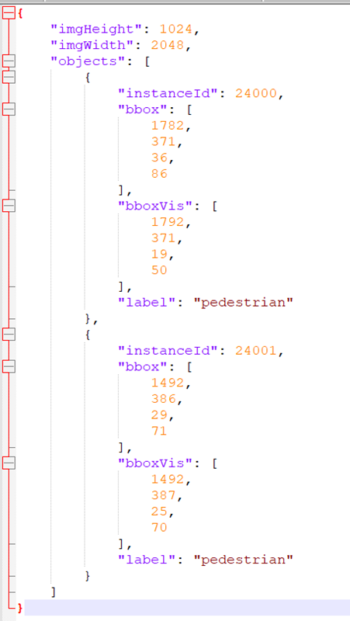
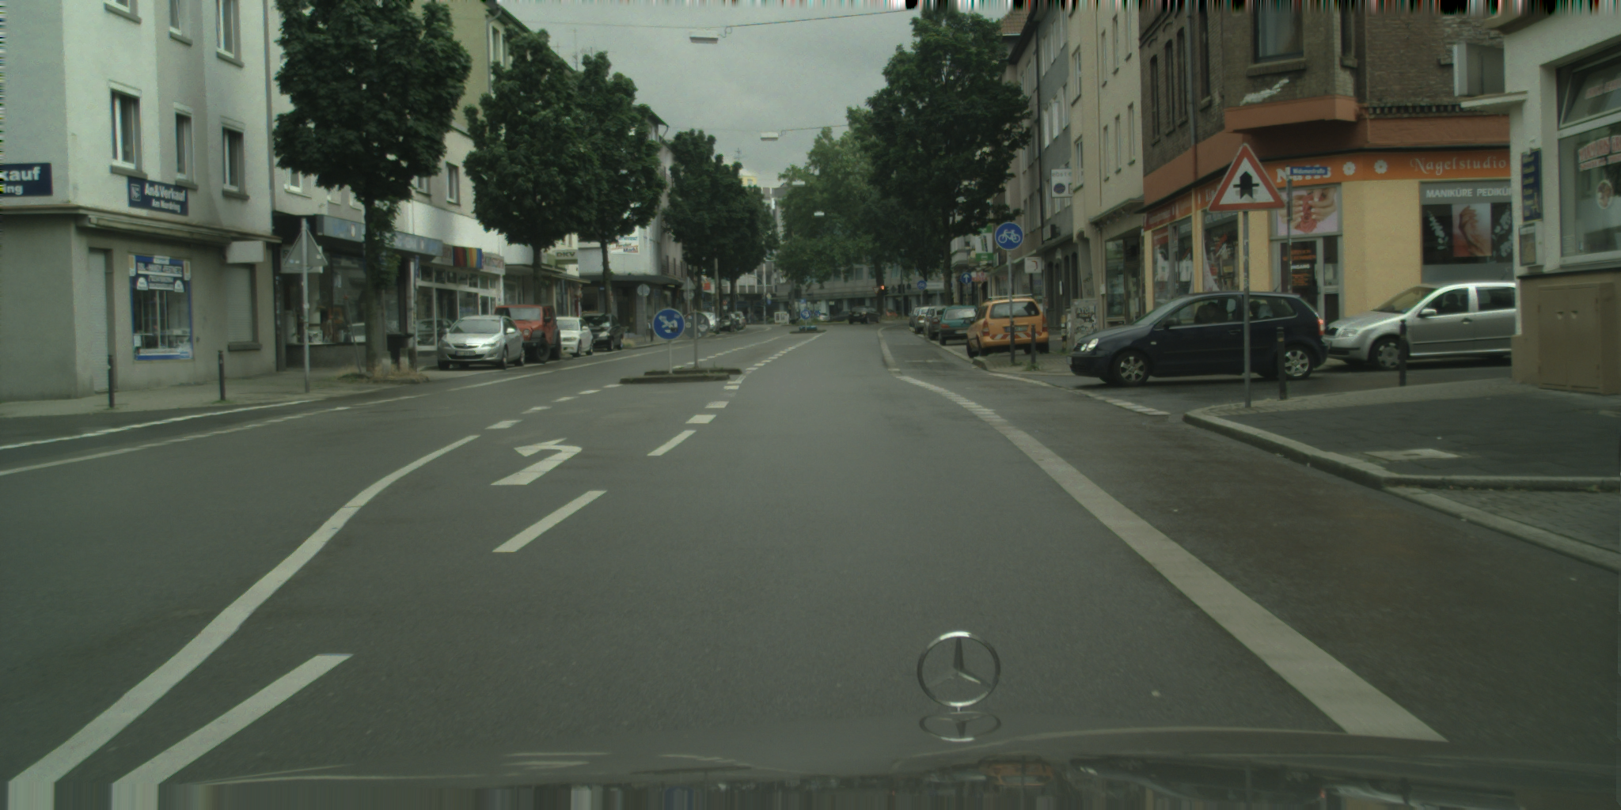
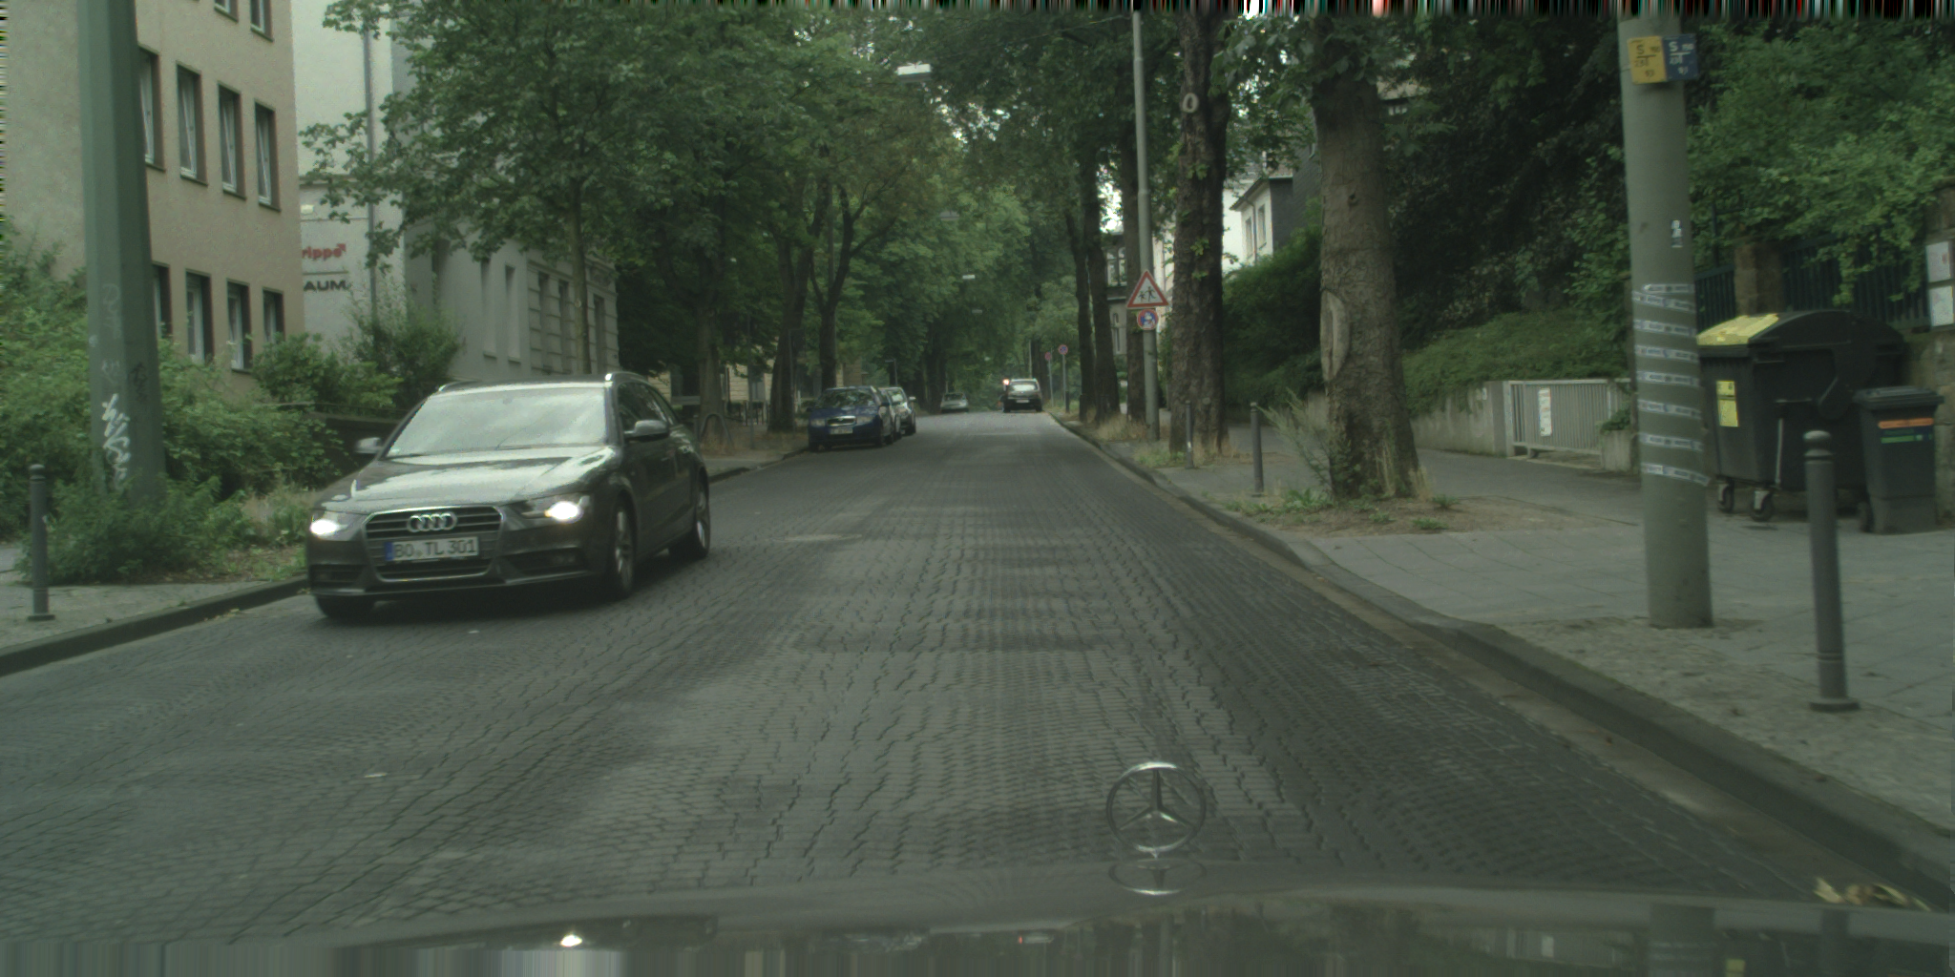
Materialization/Datasets: Cityscapes Dataset
Most Cityscapes datasets are in standardized JSON format, but cover slightly different subjects of the same scenes.
Notes:
Chris: I was the team member dedicated to materialization for the second half of the project, so I can talk about this.
We ended up drawing most of our data from Cityscapes, a dataset–or really a collection of several related datasets–mostly used for the aforementioned deep learning systems. There are images from a car’s point-of-view, and there are annotations in JSON format detailing what’s in that image and where. And then many more annotations added in layers over the next several years. Our materialization script parses three or so different JSONs for each image that we include, and lets us populate the schemas we will discuss shortly.

Slide 5

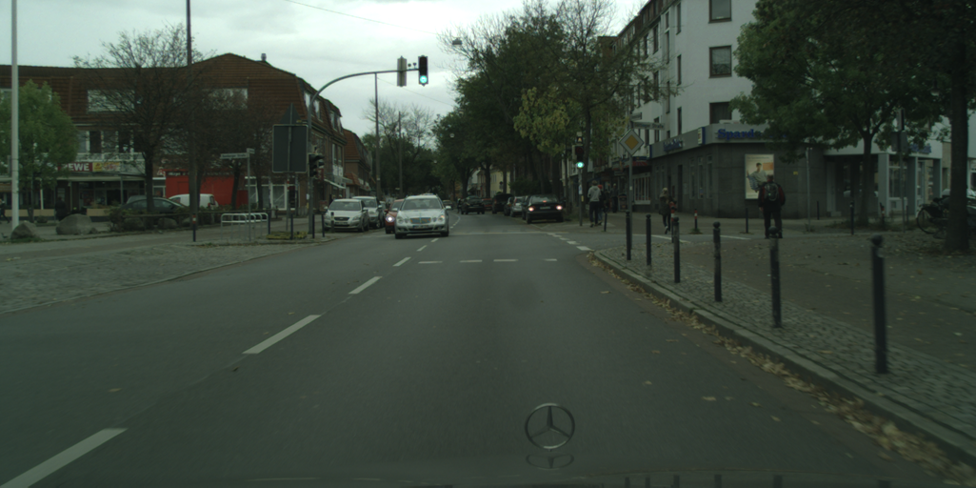
Materialization: Cityscapes Dataset
Parsing Camera Disparity for Depth Estimation
Notes:
Chris: Most objects don’t have three-dimensional annotations created by humans. But we do have data that looks like this–disparity information, computed automatically from the pair of cameras attached to the car. This works just like binocular vision. By applying a formula, we can back out estimates of the distance of objects from the camera, which is used to, admittedly somewhat loosely, populate fields about pedestrians who are standing in the road.

Slide 6
Materialization: Extra Annotations
cologne_000126_000019_leftImg8bit.png
Road A
Lane A
L24003
L24005
L24006
L24007
L24004
L24008
26003
26001
2 Illegible Sign
3 Crosswalk Sign
5 Illegible Sign
Lane B
Self
24000
R24001
R24002
24009
24010
1 Crosswalk Sign
4 Illegible Sign
Intersection Imaginary
North
Incoming
AA
Outgoing
AB
bremen_000042_000019_leftImg8bit.png
Road A
Lane A
Self
L33002
Road B
Lane A
R33000
L33004
L33003
L33005
R33001
1 Illegible Sign
2 Illegible Sign
6 Illegible Sign
7 Street Name
Road C
Lane A
R24000
3 Lane Info Sign
4 No Bicycles Sign
5 Illegible Sign
Intersection Imaginary
North
Outgoing
AA
Intersection A
South
Incoming
AA
East
Incoming
BA
West
Outgoing
CA
Notes:
So uh…we threw around different ideas about self-driving vehicles early on, but I didn’t want to commandeer the project. Our team steered pretty quickly into “Wouldn’t it be cool to do the reasoning about traffic obstacles that would enable navigation”, and in the middle weeks, we ended up down some unexpected rabbit holes about roads, and how they were structured, intersected, etc. We never really looped back to the questions about data.
Long story short, there’s a few pieces of information missing from our web datasets that are pretty crucial for tying everything together and making them work. I ended up just going back an manually adding that information, by creating indented files in the format shown here, and then adding some Python to parse them. The information here is essentially about lanes of the road, how they touch intersections in each scenario, and whether objects are on that road. So that’s now listed as one of our data sources.

Slide 7
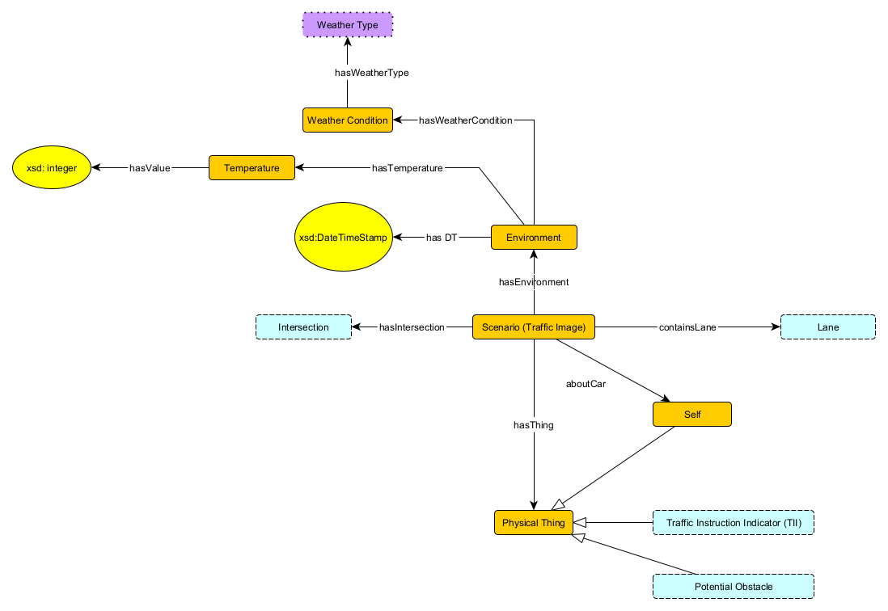
Scenario Schema
A Scenario has exactly one Environment
An Environment has up one Temperature.
A Scenario contains at least one Lane.
Every Physical Thing is within exactly one Scenario.
A Scenario has at least one Intersection
A Scenario has exactly one Self corresponding to the user's vehicle
A Temperature is represented as an integer value
Notes:
Alex: The first module is the scenario which correlates with a single traffic image.
Each scenario contains at least one lane because we should never have an image of a vehicle off-road.
Each scenario will always have at least one intersection. As you will see later in a later slide, even if there is no visible intersection, there is always an imaginary intersection behind the camera to help with the distinction of lane directions
Things such as traffic instruction indicators, potential obstacles, and the user’s vehicle (denoted as Self) are all physical things. We established in our axioms that every physical thing must exist within exactly one scenario.
We decided to include data for the environment in each scenario such as temperature and weather conditions because we suspected we could use this information in conjunction with road signs to determine road restrictions/warnings.

Slide 8
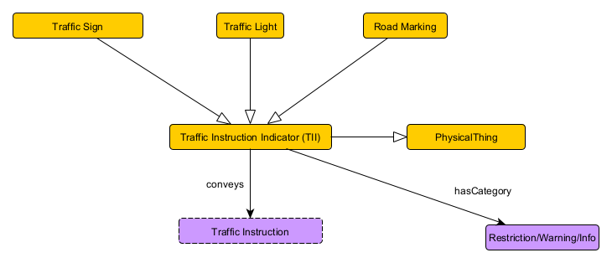
Traffic Instruction Indicator (TII) Schema
Traffic Instruction Indicator (TII) conveys a single Traffic Instruction
Traffic Instruction Indicator (TII) has exactly one category of Restriction/Warning/Info
A Traffic Sign is mutually exclusive from Traffic Light
A Traffic Light is mutually exclusive from Road Marking
Traffic Light, Road Marking, and Traffic Sign are all mutually exclusive types of Traffic Instruction Indicator (TII).
Notes:
Alex: The traffic instruction indicator refers to any indicator on the road that is intended to convey some sort of message to the driver of the vehicle.
This includes signs, lights, and road markings, all which are mutually exclusive types of TII’s from one another
Each indicator conveys a single instruction and falls within a single category of “Restriction” “Warning” or “Informational”

Slide 9
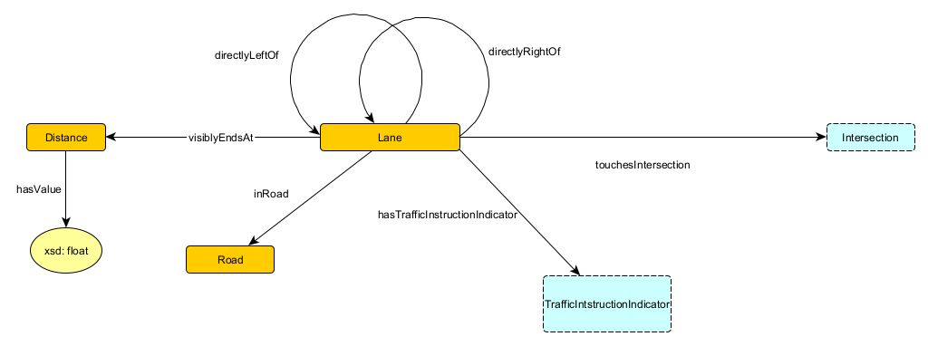
Lane Schema
A Lane can be directly left of at most one other Lane.
A Lane can be directly right of at most one other Lane.
If one Lane is directly left of another Lane, the second Lane is directly right of the first Lane.
A Lane has at most one Distance away where it visibly ends.
A Road has at least one Lane
A Lane always touches at least one Intersection.
A Lane always touches at most two Intersections.
Every Lane is in exactly one Road
A Distance is represented by a floating-point value.
Notes:
Alex: Lanes can be directly left of or directly right of at most one other lane. These relationships between lanes are inverse of one another.
A lane always touches at most two intersections and at least one intersection (if there are none visible in the scenario, there is still the imaginary intersection behind the camera)
A lane always has a non-negative amount of traffic instruction indicators on it.
A lane can have, at most, one distance at which it visibly ends
Every lane is in exactly one road, and each road must contain at least one lane.

Slide 10
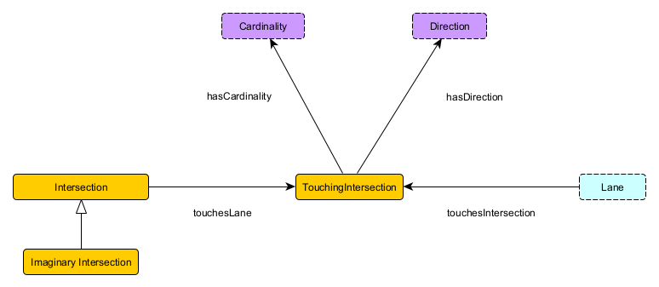
Intersection Schema
A TouchingIntersection has exactly one Direction
A TouchingIntersection has exactly one Lane
A TouchingIntersection has exactly one Cardinality
A TouchingIntersection has exactly one Intersection
A Scenario has exactly one Intersection which is an Imaginary Intersection.
Notes:
Alex: An intersection is the junction of at least two lanes.
In order to specify the direction (incoming and outgoing) and cardinality (order of lanes around intersection in cw or ccw order) of lanes in an intersection, we reified the relationship using an class called “TouchingIntersection”
This class has exactly one intersection, lane, cardinality, and direction.
As I mentioned in the Scenario schema, each scenario contains a single Imaginary Intersection which is an Intersection
(Chris: We could mention that this is the one that blew up out of nowhere–we needed Cardinality to reason about turns, and direction to reason about the direction of lanes)

Slide 11
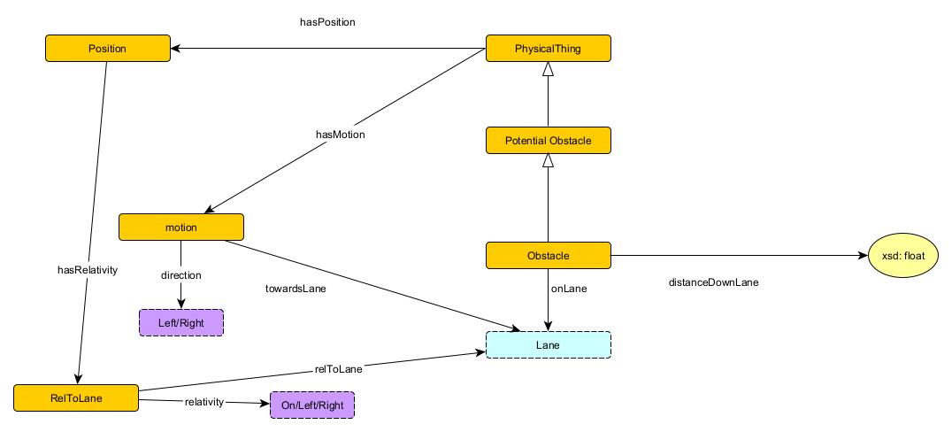
Potential Obstacle Schema
A Position is always in at most 2 Lanes.
The Position of a Potential Obstacle is either on a Lane, or to the right or left of a Lane.
A Position is always given relative to a single Lane.
A Motion is either to the left or right (implicitly relative to the current Road.)
A Motion is always towards at least one Lane.
If the Position of a Potential Obstacle is on no Lanes, that P.O. isn’t an Obstacle. Otherwise, it is.
Notes:
Alex: A potential obstacle is a physical thing in our scenario that has position and motion relative to the lanes in the scenario.
The motion of the potential obstacle may be to the right or left of any lane based on the camera’s view.
The position of the potential obstacle can be right of, left of, or on a lane, and is always given relative to a single lane.
If a potential potential obstacle is on a lane, it is considered an obstacle, and has a float value representing its distance down the lane.
(Chris: We could talk about how we decided to represent position as a function of “lane”, rather than exact 3d coordinates, because it was at the appropriate level of abstraction for our questions)

Slide 12
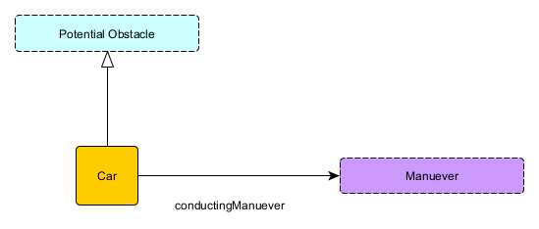
Car Schema
A Car is always conducting exactly one Maneuver.
Notes:
Alex: Our car schema correlates with any car within the scene not including Self. These vehicles are considered potential obstacles and are always conducting exactly one maneuver

Slide 13
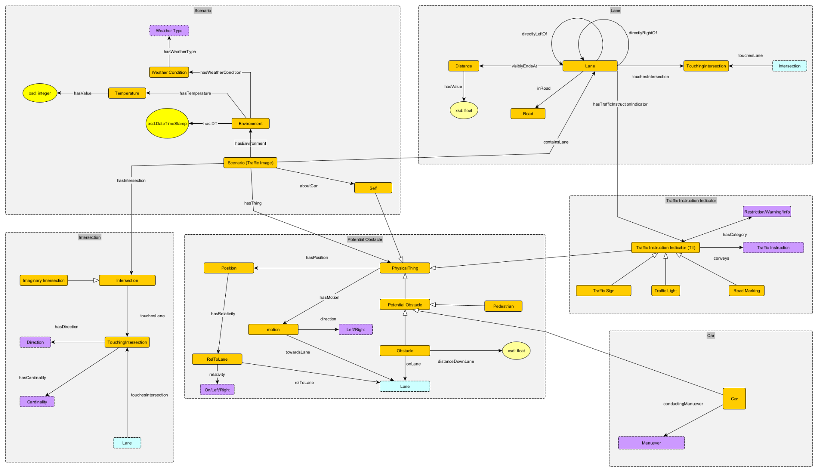
All Schema
Other axioms:
All stubs (using the hasValue relationship) point to an xsd primitive.
Notes:
Alex: This is our total schema including all of the modules

Slide 14
Usage (Queries + Results)
Competency Question: "Which scenarios contain more than 4 Cars?"
Uses knowledge graph elements & rules to provide statistical information.
Simplest SPARQL query
Query shows relationship between scenarios and all physical things.
Uses aggregates of SPARQL to conduct specific operations within the query.
Competency Question: "In which scenarios can the car merge to the right and/or left?"
Uses knowledge graph elements & rules to turn situational awareness into actionable driving knowledge
Longest SPARQL query
Queries, rather than axioms, embody significant chunks of “the rules of the road”
Multiple checks required: Merging Right vs. Left, different reasons merging could be disallowed, etc.

Slide 15
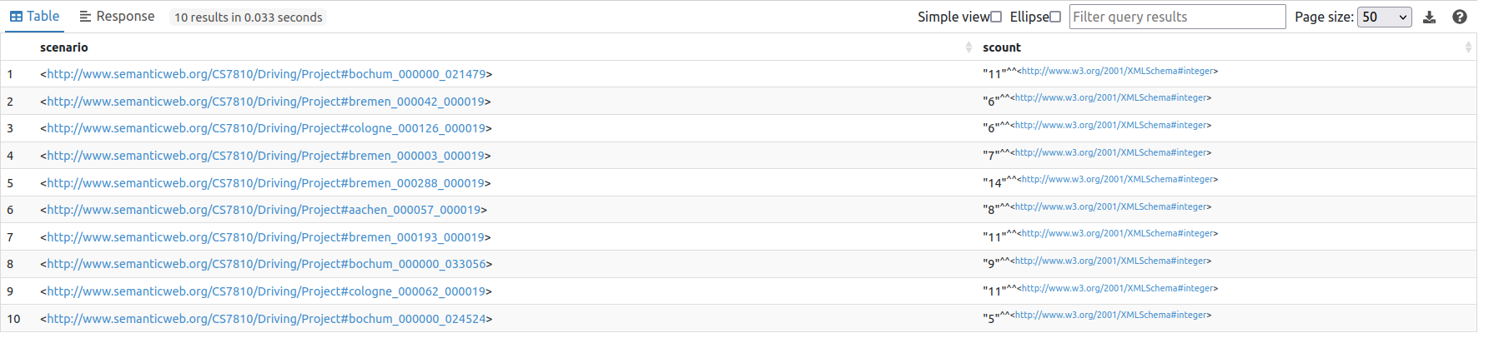
SELECT DISTINCT ?scenario (COUNT(?car) as ?scount) where {
?scenario a :Scenario .
?scenario :hasThing ?car.
?car a :Car .
} GROUP BY ?scenario
HAVING (?scount>4)

Slide 16
SELECT DISTINCT ?scenario ?lane ?lane1
WHERE {
{
?scenario a :Scenario .
?scenario :aboutCar ?self .
?scenario :containsLane ?lane .
?self a :Self .
?self :hasPosition ?position .
?position :hasRelativity ?rel .
?rel :relToLane ?lane .
?lane a :Lane .
?lane :directlyLeftOf ?lane1 .
?lane :touchesIntersection ?touchInter .
?lane1 :touchesIntersection ?touchInter1 .
?intersection a :Intersection .
?intersection :touchesLane ?touchInter .
?intersection :touchesLane ?touchInter1 .
?touchInter :hasDirection ?dir .
?touchInter1 :hasDirection ?dir1 .
FILTER(?dir = ?dir1)
FILTER NOT EXISTS{
?scenario :hasThing ?thing .
?thing :hasPosition ?position1 .
?position1 :hasRelativity ?rel1 .
?rel1 :relToLane ?lane1 .
?rel1 :relativity :On-Left-Right.On .
}
}
UNION
{
?scenario a :Scenario .
?scenario :aboutCar ?self .
?scenario :containsLane ?lane .
?self a :Self .
?self :hasPosition ?position .
?position :hasRelativity ?rel .
?rel :relToLane ?lane .
?lane a :Lane .
?lane :directlyRightOf ?lane1 .
?lane :touchesIntersection ?touchInter .
?lane1 :touchesIntersection ?touchInter1 .
?intersection a :Intersection .
?intersection :touchesLane ?touchInter .
?intersection :touchesLane ?touchInter1 .
?touchInter :hasDirection ?dir .
?touchInter1 :hasDirection ?dir1 .
FILTER(?dir = ?dir1)
FILTER NOT EXISTS{
?scenario :hasThing ?thing .
?thing :hasPosition ?position1 .
?position1 :hasRelativity ?rel1 .
?rel1 :relToLane ?lane1 .
?rel1 :relativity :On-Left-Right.On .
}
}
}
Notes:
Consider running modified versions of this query live (i.e., without the checks on lane direction) that show that it has multiple parts filtering out various conditions which stop the maneuver from being legal (lane existence, obstacle presence, lane direction)

Slide 17
Demo Here

Slide 18
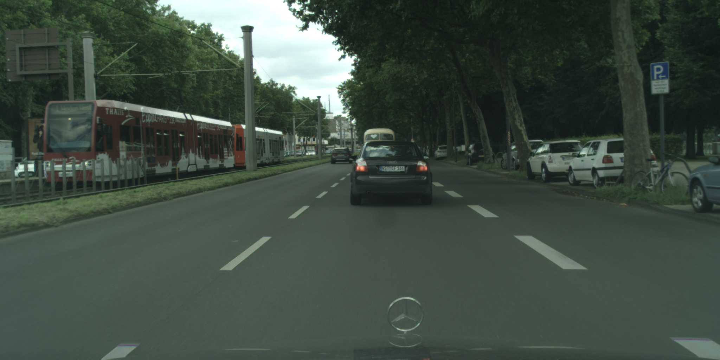
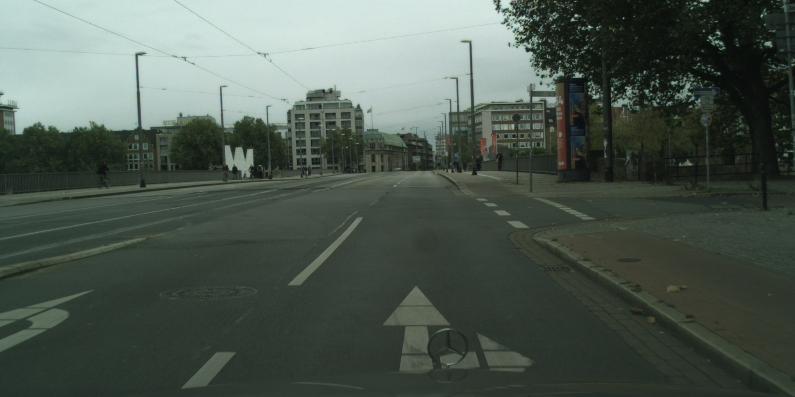
Scenarios Found
Can merge left into an empty lane
Can merge right into an empty lane

Slide 19
Retrospective
Christopher Menart
More Directions for Reading Material
Lectures/Involvement throughout project portion of course
Rating: Fun*, Useful
Jehan Fernando
Better explanation in class description
More Directions for setting up software
Rating: Informative, Team format was enjoyable.
Alex Moore
Split semester between lectures and group work
Record lectures as videos and put them on Pilot for review
Rating: Enjoyed organization; Most enjoyable when queries were returning appropriate results; Overall useful class and group work
Notes:
In this section, put 1-2 comments per group member
Include comments re: what went will in this course, what could be changed
Provide an overall rating for the course: fun/!fun, useful/!useful, etc.
(from requirements)

